Slide 1

Capstone Project- Visualizing Key Performers in Cricket
Group 2

Slide 2


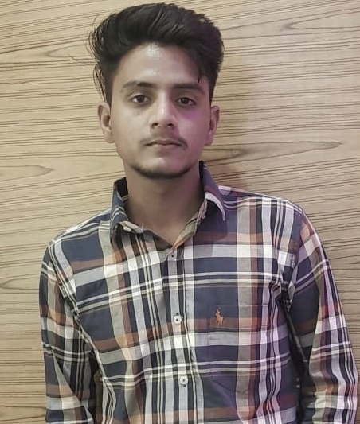
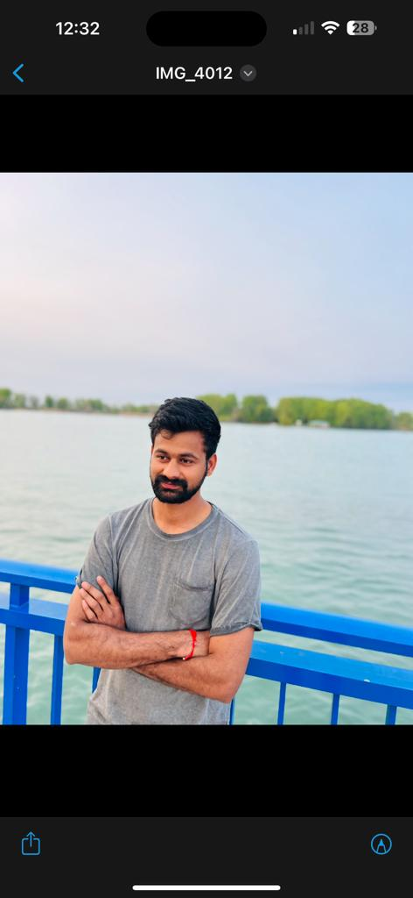

Team Introduction
Sumanth Reddy Gajjala
w0816129
Surya Narasimha Manikanta PavanKumar Akula Jaya
w0811656
Sachin Kashyap
w0832574
Sai Venkata Krishna Reddy Boyapati
w0813504
Akhil Inaganti
w0811914

Slide 3
Agenda
Introduction
Problem Statement
Dataset Information
Methodology
Dashboard
Key Insights
Challenges
Future Work

Slide 4

Introduction to Project
Our project is based on Cricket analysis in which we will analyze the player and team performance according to their past result in the matches and this analysis will be done on IPL matches data.

Slide 5
Problem Statement
In the world of cricket, brands seeking to optimize their marketing strategies face the challenge of identifying the most suitable IPL player for effective promotion. This project aims to leverage comprehensive data analysis of IPL match, social media, and player attributes to determine the optimal player profile that aligns with the brand's goals, values, and target audience. The objective is to provide actionable insights for brands to make informed decisions in selecting the ideal player for successful and impactful promotional campaigns.

Slide 6
Data Information
Data collected from website cricsheet.org.
Converted JSON format to csv.
126,855 Rows and 82 Columns.
City, Date, Winner, bowler, overs and batter are few of the key columns.

Slide 7
Methodology
To facilitate analysis, the JSON data was converted into a structured CSV format. The conversion process involved using the .NET framework.
The Pandas library in Python was employed to perform comprehensive data cleaning. This involved addressing missing values, and handling any outliers that might impact the quality of the analysis.

Slide 8
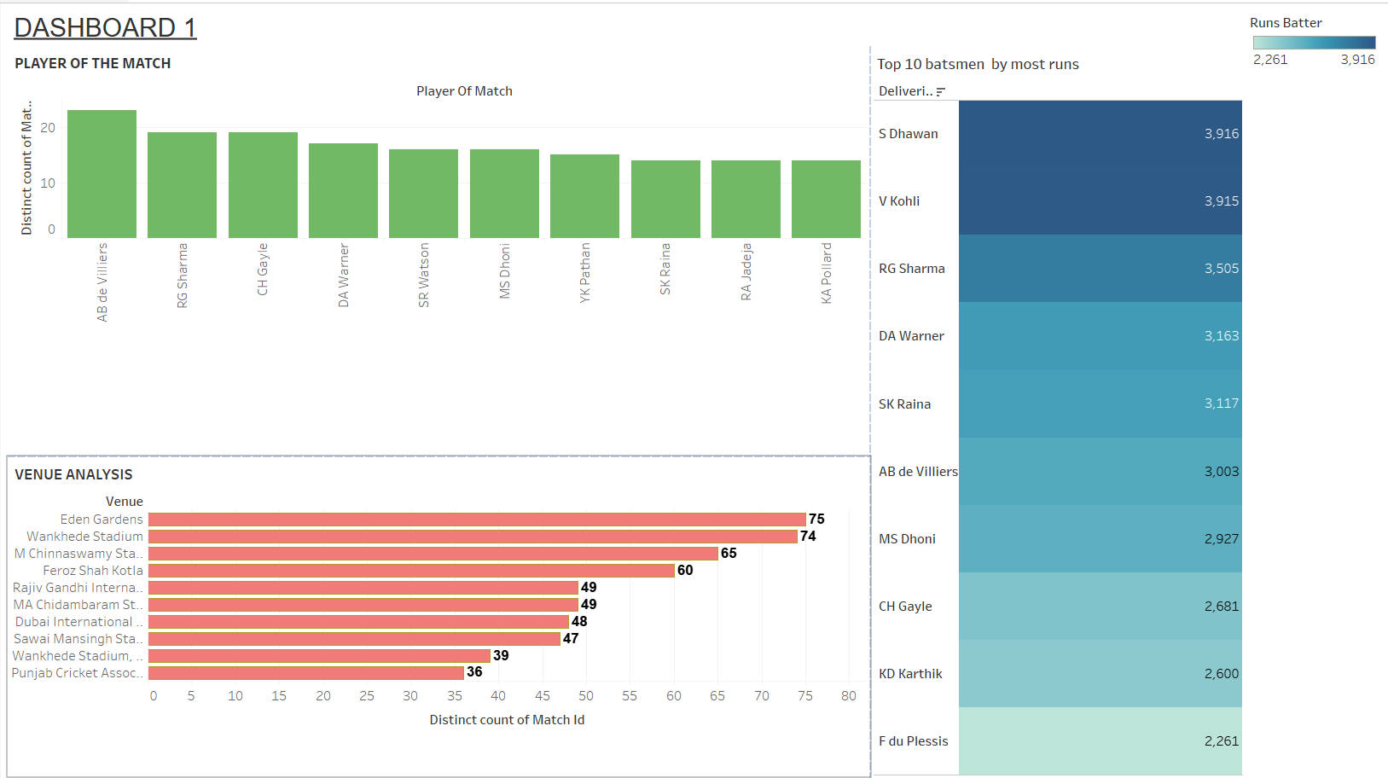

Slide 9
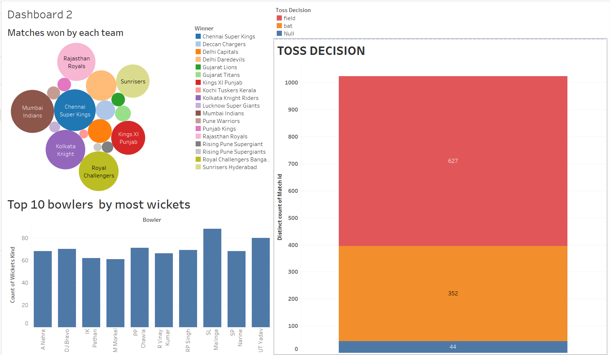

Slide 10
Insights
Mumbai Indians, Chennai Super Kings, and Royal Challengers Bangalore have consistently performed well, winning the most matches. This suggests a strong and consistent performance by these teams over time.
AB de Villiers and Rohit Sharma stand out with more "Player of the Match" awards. Their individual contributions have often been recognized as match-defining.
Shikhar Dhawan and Virat Kohli, with more runs, showcase exceptional batting prowess. Their consistent run-scoring ability is crucial for their respective teams.
The trend of choosing to field first in most toss decisions suggests a strategic approach by teams. This decision might be influenced by factors such as pitch conditions, weather, and team strengths.

Slide 11
Challenges
The initial data was in JSON format, and the conversion to CSV using the .NET framework presented difficulties.
The data received in CSV format may contain inconsistencies or incomplete records.
Cleaning the CSV data proved to be a complex task, likely due to the volume of null values and other inconsistencies.

Slide 12
Future Work
Match players with brands that share similar values or target similar markets.
Consider the players' Twitter engagement metrics as indicators of their influence and potential impact for brands.
Implementation of machine learning models to predict player performance using historical data.

Slide 13
THANK YOU

Slide 14
Critic for Group 5
Q. What do you like about the Project Presentation?
Presentation design is good.
Topic of the project is relative and useful.
Q. What do Project Presentation can improve?
Visualizations seems misunderstanding.
Out of scope future works.

Slide 15
Critic for Group 1
Q. What do you like about the Project Presentation?
common crime types dashboard is good.
Key insights were good.
Nice idea about the future work.
Q. What do Project Presentation can improve?
Presentation font is too hard to depict. It strains the eyes too much.
Victim race should have been avoided when presenting in public.

